Slide 1
11/11 Visual Aid

Slide 2
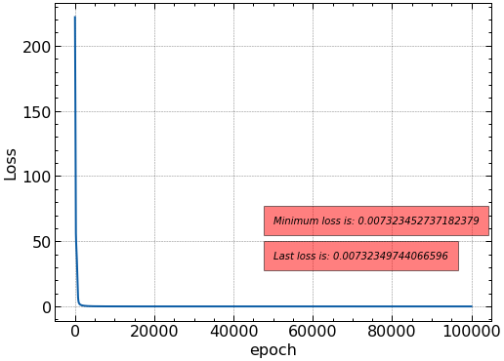
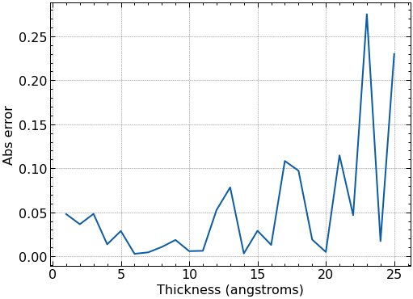
For thickness = 1-25 Angstroms, 1 angstrom resolution, Al: We first train an algorithm to “distinguish” thickness.

Slide 3
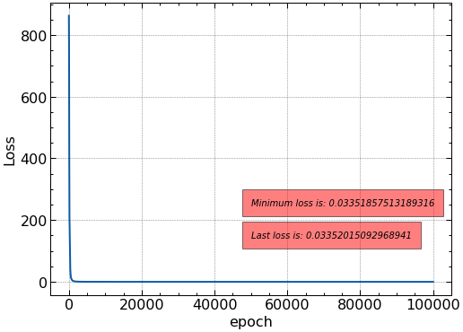
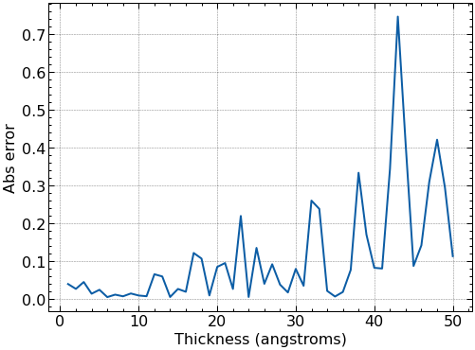
For thickness = 1-50:

Slide 4
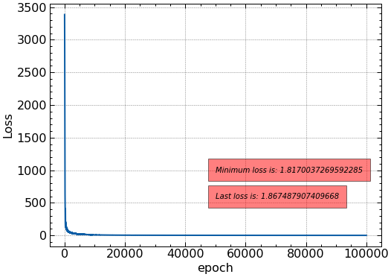
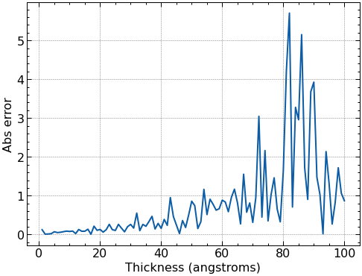
For thickness = 1-100:

Slide 5
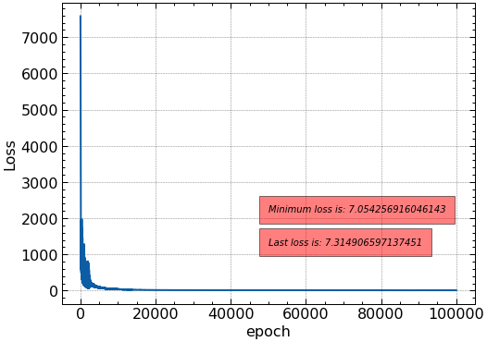
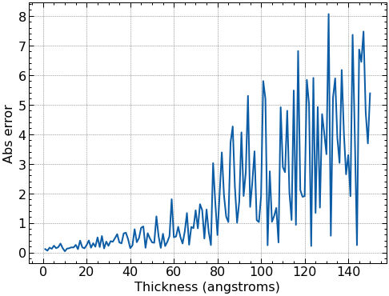
For thickness = 1-150:

Slide 6
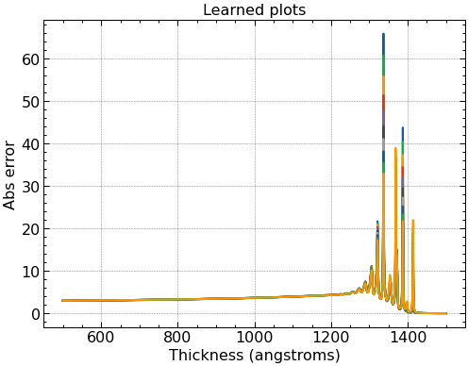
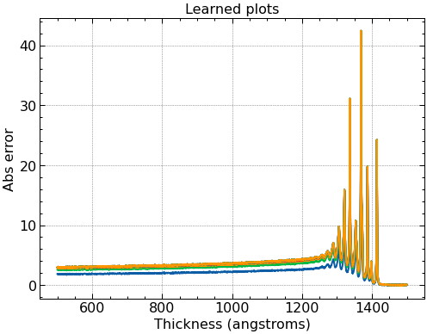
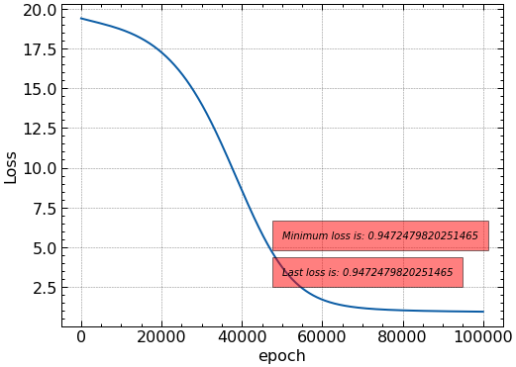
For thickness = 1-25 Angstroms, 1 angstrom resolution, Al: We train an algorithm to produce images given thicknesses.
Respectively, Actual vs. learned plots:
X-axis SHOULD be energy, Y should be counts.

Slide 7
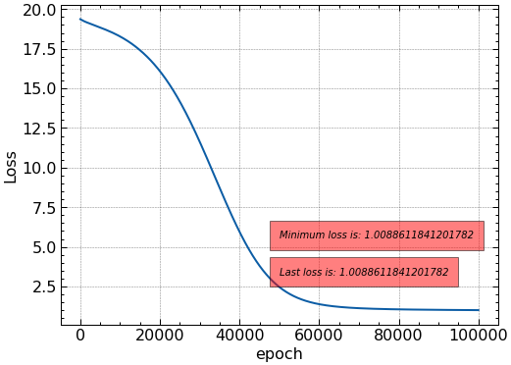
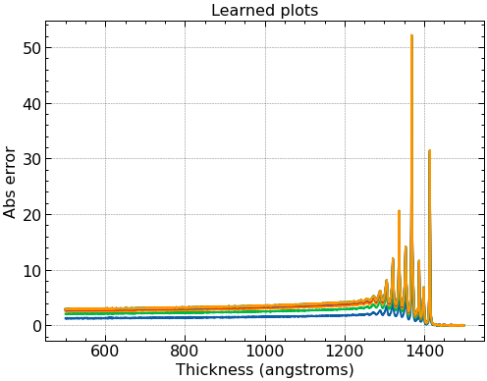
For thickness = 1-50:

Slide 8
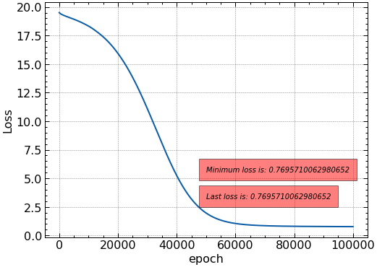
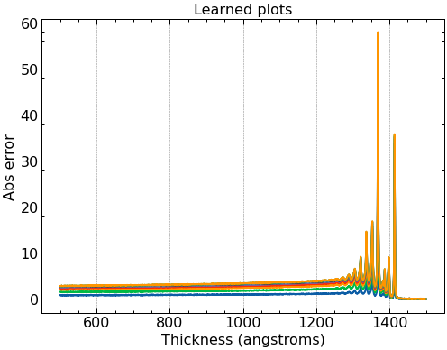
For thickness = 1-100:

Slide 9

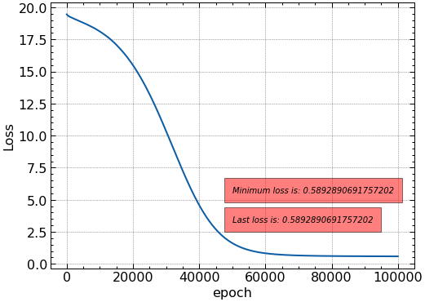
For thickness = 1-150:

Slide 10
Adding training data to both decreases mean error, but increasing data range for distinguishing algorithm particularly increases loss (as one would expect, since distinguishing higher thicknesses gets harder, and harder).
Adding training data to production algorithm uniquely drops loss, despite increasing number of data points.
From the above, we should attempt to use far more training data.
Honestly though, algorithms weren’t trained to hard for the sake of time.

Slide 11
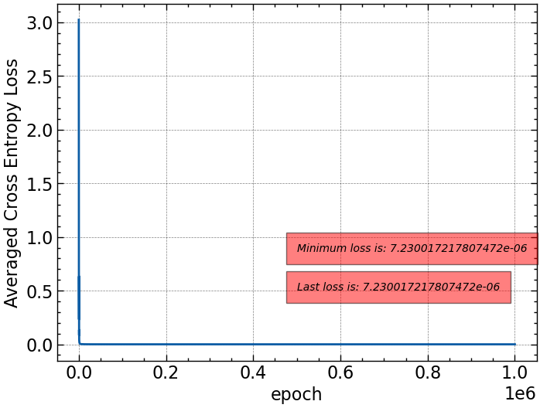
Distinguishing Materials: All thicknesses are 10 angstroms.

Slide 12
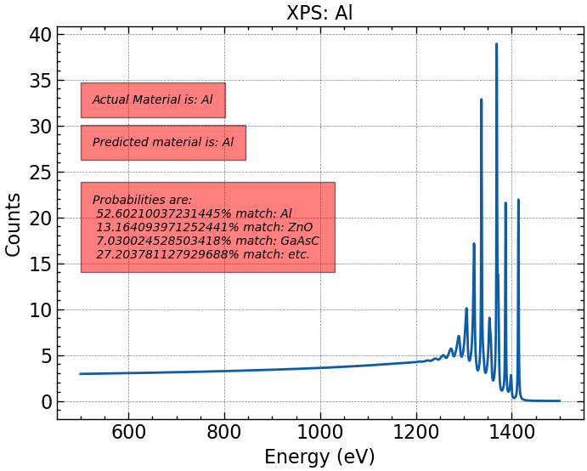
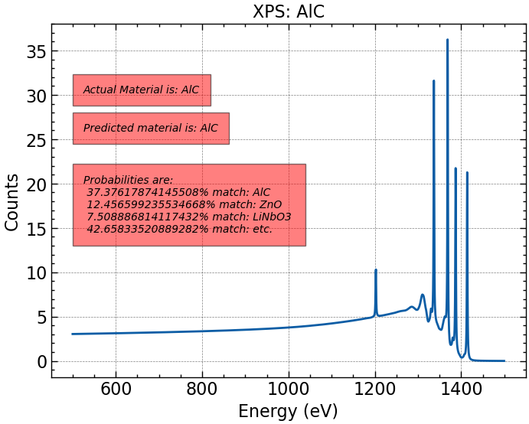
Note: Materials with “C” ending have a 0.5 angstrom layer of adventitious carbon (I forgot it was 0.5 nm ☹, but it should serve as a simple simulation for a thin layer size as given).

Slide 13
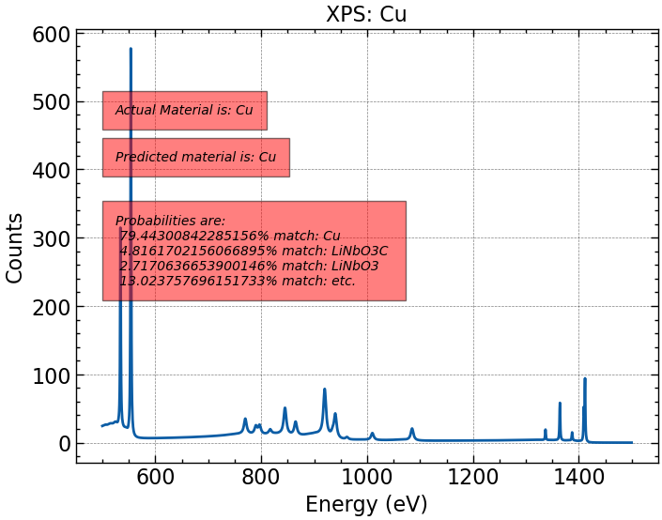
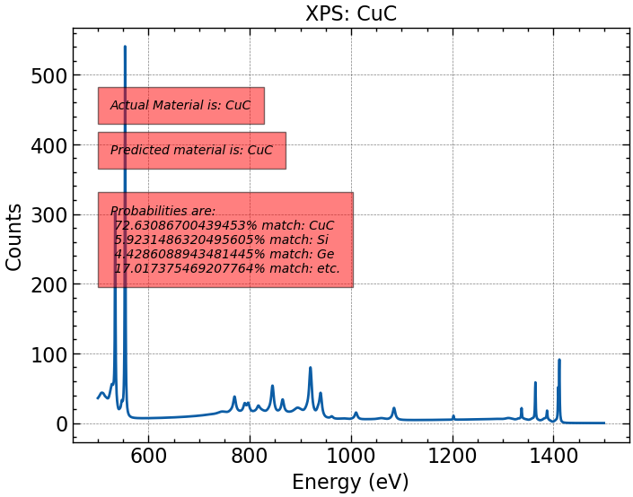

Slide 14
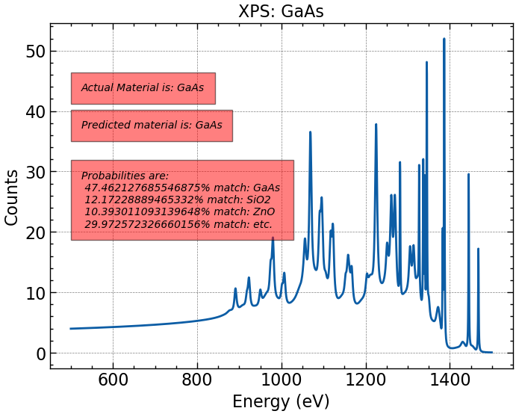
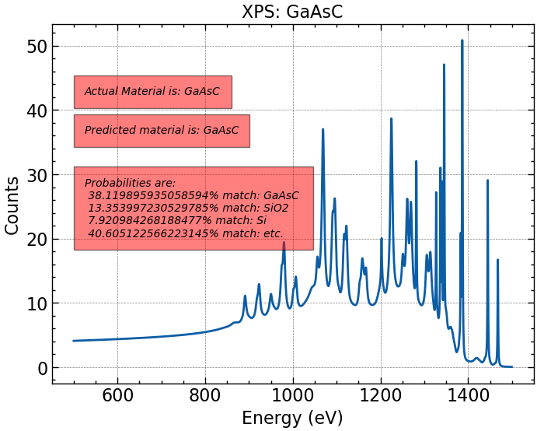

Slide 15
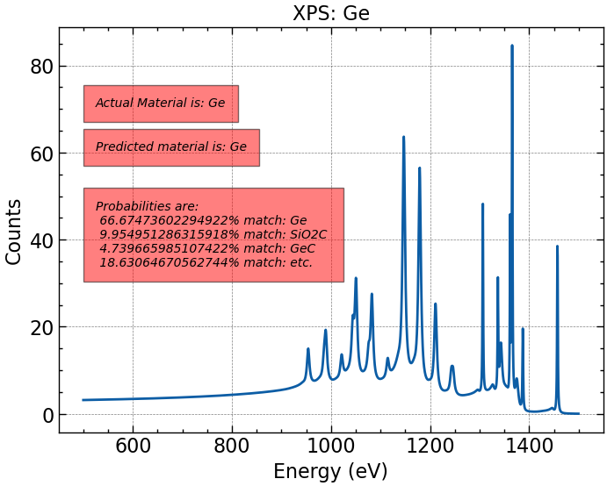
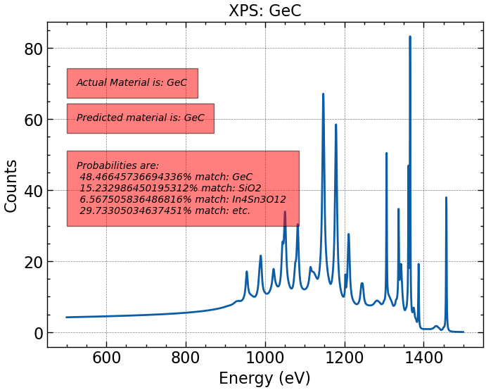

Slide 16
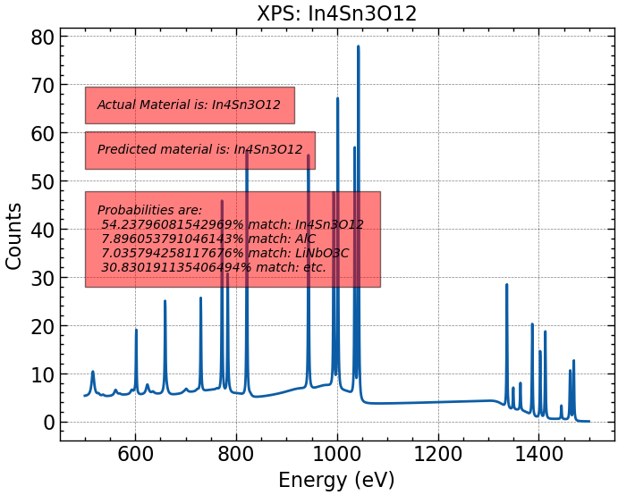
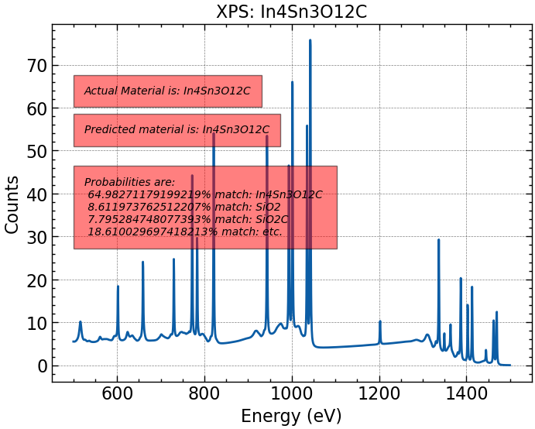

Slide 17
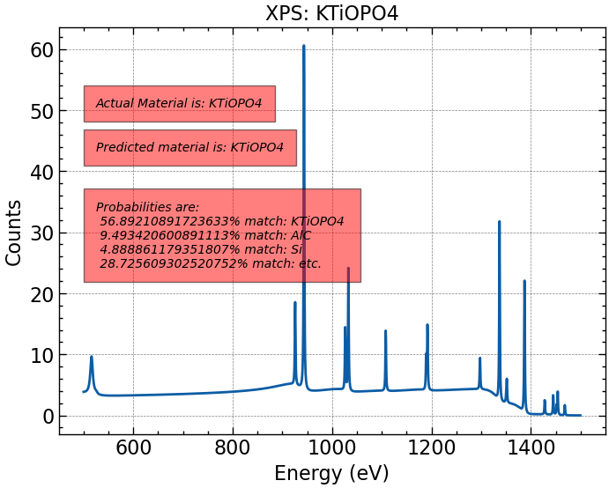
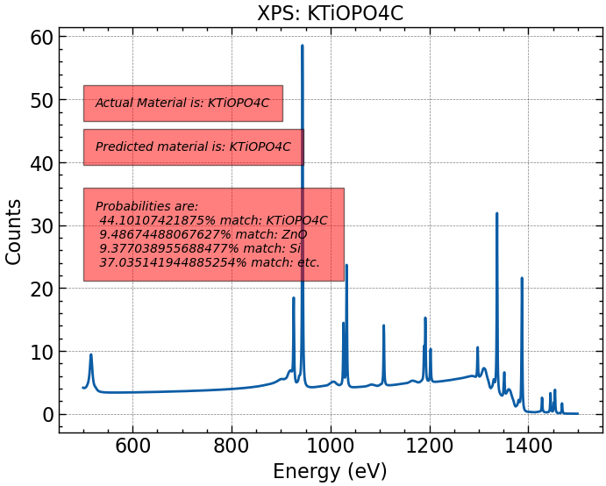

Slide 18
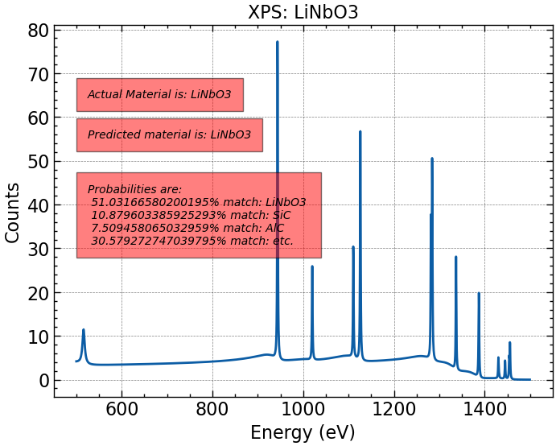
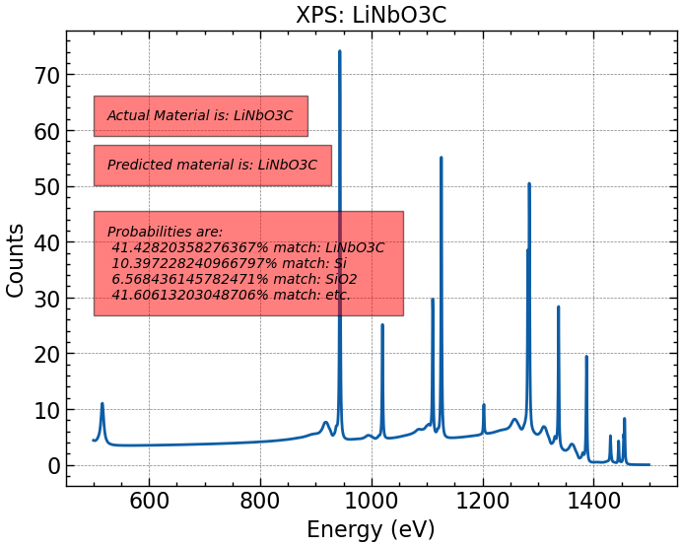

Slide 19
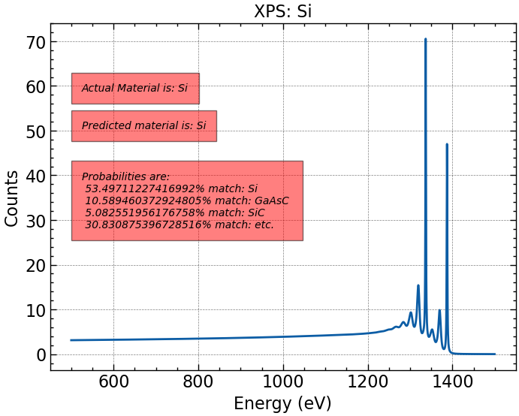


Slide 20
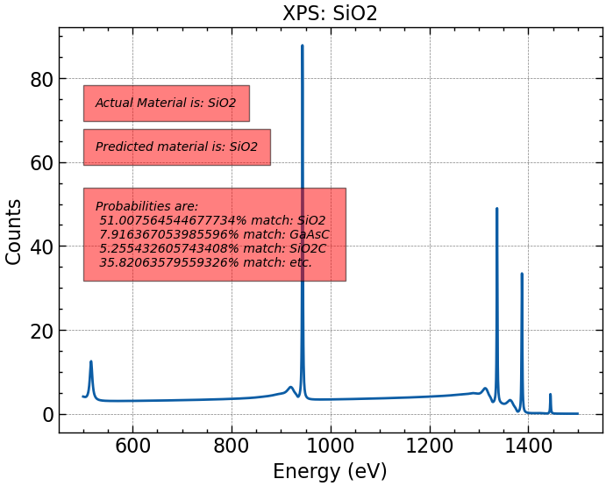
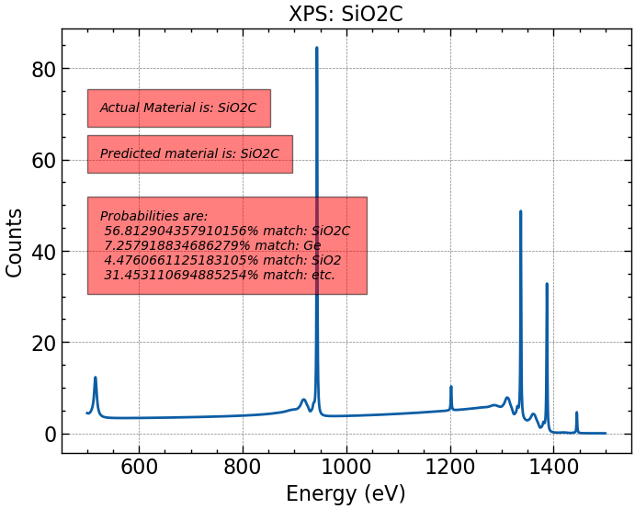

Slide 21
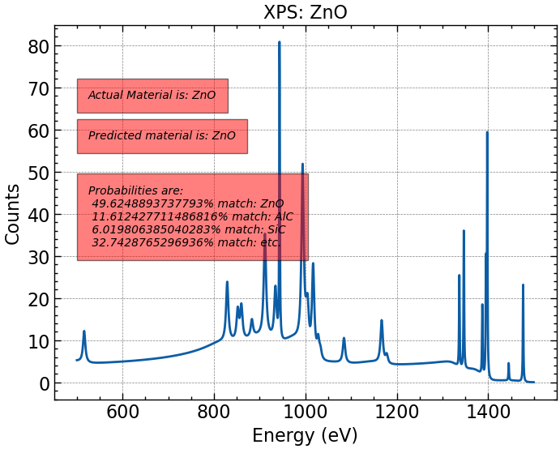
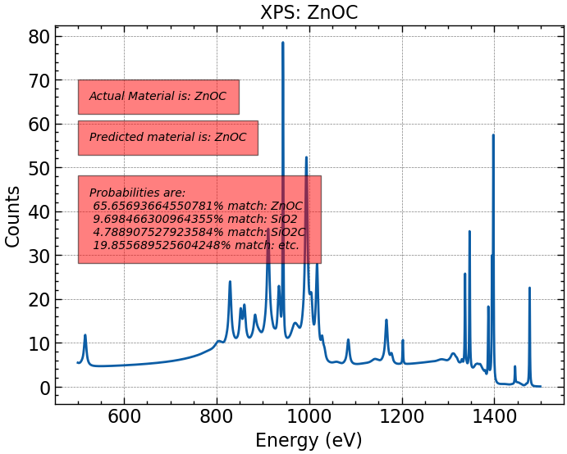

Slide 22
Next:
Attempt to implement thickness and material permutations:
We can do this with a classification algorithm for identification (way easier).
A continuous algorithm is more adequate for production of plots as opposed to identification.
Would like to produce thousands of images in between prior thicknesses to see if thickness algorithms function noticeably better.
Should we strive for a better identification rate for the materials? 50% over 20 materials seems pretty good!

